Slide 1

ML Algorithms
Naive Bayes

Slide 2
Naive Bayes
The Naive Bayes classifier is a probabilistic machine learning algorithm based on Bayes' Theorem.
It assumes that the features are conditionally independent, given the class label (hence the term "naive").
Despite this strong and often unrealistic assumption, Naive Bayes has shown to work well in practice, especially for large datasets.

Slide 3

Bayes' Theorem
Bayes' Theorem is the foundation of Naive Bayes. It calculates the probability of a class given some features. The formula is:
Where:
P(C∣X) is the posterior probability of the class C given the features X.
P(X∣C) is the likelihood of observing features X given the class C.
P(C) is the prior probability of the class C (the probability of the class occurring before observing any features).
P(X) is the evidence (the probability of the features occurring).

Slide 4
Steps for Naive Bayes Classification
1. Calculate the Prior Probabilities:
The prior probability is the probability of each class occurring in the dataset. This can be calculated by dividing the number of occurrences of each class by the total number of instances.
2. Calculate the Likelihood:
For each feature, calculate the probability of observing the feature value given the class. This is typically calculated for each class by considering how often each feature value occurs within each class.
3. Apply Bayes' Theorem:
Use Bayes' Theorem to calculate the posterior probability for each class, given the features.
4. Choose the Class with the Highest Posterior Probability:
The class with the highest posterior probability is the predicted class for the instance.

Slide 5
Example
Problem:
Let's consider a simple example where we are classifying whether a student passes or fails based on two features: study time (short, long) and attendance (low, high). The target variable is whether the student passes or fails.
Study Time | Attendance | Result
short | low | fail
short | high | fail
long | low | fail
long | high | pass
short | low | fail
short | high | pass
long | high | pass
long | high | pass
short | low | fail

Slide 6
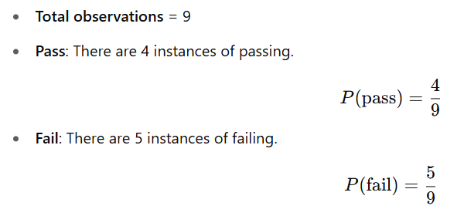
Step 1: Calculate Prior Probabilities
First, calculate the probability of each class (pass or fail).

Slide 7
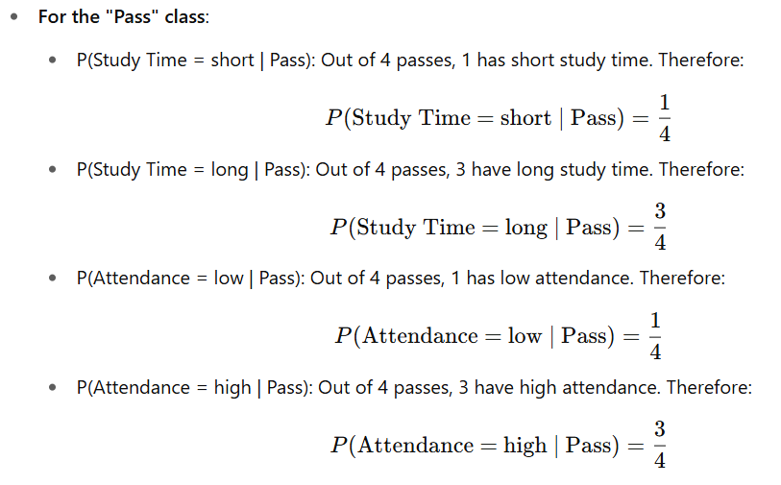
Step 2: Calculate Likelihoods
Now, for each feature, calculate the likelihood of the feature given the class (pass/fail). We will calculate the probability of each feature (study time and attendance) for both classes.

Slide 8
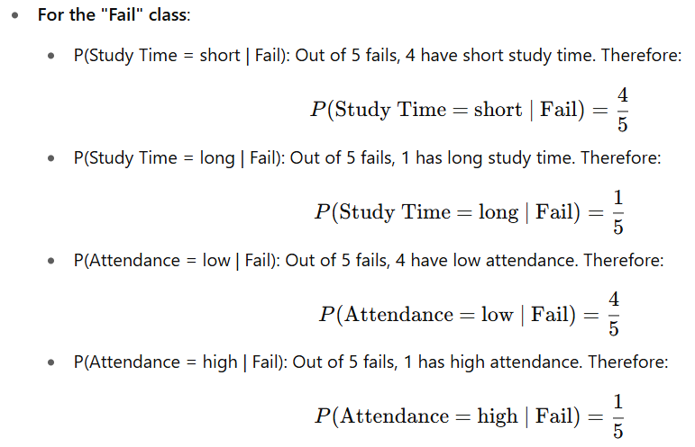

Slide 9
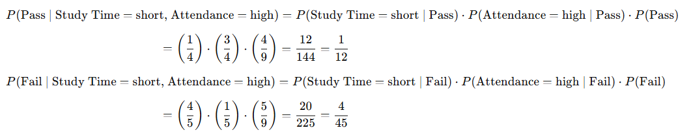
Step 3: Calculate Posterior Probabilities
Now we can calculate the posterior probability for each class. Let’s assume we want to predict the result for a student with the following features: Study Time = short, Attendance = high.
Using Bayes' Theorem, the posterior probability of Pass and Fail is calculated as follows:

Slide 10
Step 4: Compare and Choose the Class with the Highest Posterior Probability
Now, we compare the posterior probabilities for Pass and Fail:
P(Pass) = 1/12
P(Fail) = 4/45
Since 1/12 is greater than 4/45​, the predicted class is Pass.

Slide 11
Practice
Problem Statement:
You are working for a weather forecasting service. Based on historical data, you need to classify whether it will Rain or No Rain based on the following features:
Outlook | Temperature | Humidity | Wind | Rain
Sunny | Hot | High | Weak | No
Sunny | Hot | High | Strong | No
Overcast | Hot | High | Weak | Yes
Rainy | Mild | High | Weak | Yes
Rainy | Cool | Low | Weak | Yes
Rainy | Cool | Low | Strong | No
Overcast | Cool | Low | Strong | Yes
Sunny | Mild | High | Weak | No
Sunny | Cool | Low | Weak | Yes
Rainy | Mild | Low | Weak | Yes

Slide 12
New Instance= (Outlook= Rainy, Temp= Mild, Humidity= High, Wind= strong)

Slide 13
Machine Learning Algorithm Performance Evaluation
When evaluating machine learning models, it's important to understand how well the model is performing.
1. Confusion Matrix
The confusion matrix is a table used to evaluate the performance of a classification algorithm. It shows the actual vs. predicted classifications and helps to visualize the performance of a model.
For a binary classification problem (e.g., "Positive" vs. "Negative"):
 | Predicted Positive | Predicted Negative
Actual Positive | True Positive (TP) | False Negative (FN)
Actual Negative | False Positive (FP) | True Negative (TN)
Notes:
True Positive (TP): The number of instances correctly predicted as positive.
False Negative (FN): The number of instances that are actually positive but were predicted as negative.
False Positive (FP): The number of instances that are actually negative but were predicted as positive.
True Negative (TN): The number of instances correctly predicted as negative.

Slide 14

2. Accuracy
Accuracy measures how often the classifier correctly predicted the class label. It is the ratio of correctly predicted instances (both true positives and true negatives) to the total number of instances.
Accuracy is useful when the classes are balanced (i.e., there are roughly equal numbers of positive and negative samples). However, it can be misleading if the dataset is imbalanced (e.g., when one class is much more frequent than the other).

Slide 15

3. Precision
Precision measures the proportion of positive predictions that are actually correct. In other words, it tells us how many of the instances predicted as positive are actually positive.
Precision is important when the cost of false positives is high. For example, in email spam detection, you may want to make sure that emails flagged as "spam" are truly spam, so you care about high precision.

Slide 16

4. Recall (Sensitivity or True Positive Rate)
Recall measures the proportion of actual positives that were correctly identified by the classifier. In other words, it tells us how many of the actual positive instances were detected by the model.
Recall is important when the cost of false negatives is high. For example, in medical testing, you want to catch as many positive cases as possible (e.g., cancer), so a high recall is desired, even if it means some false positives.

Slide 17

5. F1-Score
F1-Score is the harmonic mean of precision and recall. It is used when you need a balance between precision and recall, and there is an uneven class distribution (i.e., when false positives and false negatives have different costs).
The F1-Score is a good metric to use when you need to balance precision and recall. A high F1-Score indicates that the classifier has both high precision and high recall.

